Slide 1
CAPSTONE PROJECT
Secure Data Hiding in Image Using Steganography
Presented By
Student Name : Immadisetti Pavani
College Name : Bapatla Engineering College
Department : Information Technology

Slide 2
OUTLINE
Problem Statement
Technology used
Wow factor
End users
Result
Conclusion
Git-hub Link
Future scope

Slide 3
Problem Statement
The challenge involves securely embedding sensitive data within an image using steganography, ensuring confidentiality and preventing unauthorized access. Unlike traditional encryption, which may draw attention to hidden data, steganography conceals information within image pixels in a way that preserves the original appearance, making detection difficult. The goal is to develop an efficient algorithm that can seamlessly embed and extract data while maintaining image quality, minimizing distortions, and ensuring robust security. The solution should also account for resistance against image processing operations such as compression, resizing, and filtering, while optimizing computational efficiency for practical use cases..

Slide 4
Technology used
Libraries Used:
Standard Libraries: stdio.h, stdlib.h, string.h, OpenCV (cv2) , OS
Custom Header: "steganography.h"
Platforms:
Operating System: Windows
File Format: JPG (Bitmap Image)
Additional Points:
Steganography Method: Least Significant Bit (LSB) Encoding
Data Handling: Embeds and extracts text data from images

Slide 5
Wow factors
1️⃣ LSB-Based Steganography – Embeds data in the Least Significant Bit (LSB) of image pixels, ensuring seamless concealment without perceptible changes to the image. This enhances security while maintaining visual fidelity.
2️⃣ Lossless BMP Processing – Operates on uncompressed BMP images, preserving data integrity and ensuring accurate extraction without quality degradation.
3️⃣ High Performance & Efficiency – Implemented in C for superior speed and memory efficiency, significantly outperforming Python- and Java-based steganography tools.
4️⃣ User-Friendly CLI Interface – Designed with a simple yet powerful command-line interface (CLI), enabling effortless embedding and extraction of hidden data, making it ideal for automation and batch processing.

Slide 6
End users
1️⃣ Cybersecurity Professionals – Leverage steganography for secure data transmission, covert communication, and digital forensics, ensuring confidential information remains undetected by unauthorized entities.
2️⃣ Forensic Experts – Analyze and extract concealed data from images to uncover hidden evidence in cybercrime investigations, fraud detection, and digital forensics.
3️⃣ Government & Defense Agencies – Utilize steganography to embed classified intelligence within images, facilitating secure communication, espionage, and confidential military operations.
4️⃣ Researchers & Academics – Explore and enhance steganographic techniques to improve data security, cryptographic methods, and resistance against steganalysis attacks.
5️⃣ Privacy-Conscious Individuals – Protect personal or sensitive information from cyber threats by embedding private data within images, ensuring confidentiality and preventing unauthorized access.

Slide 7
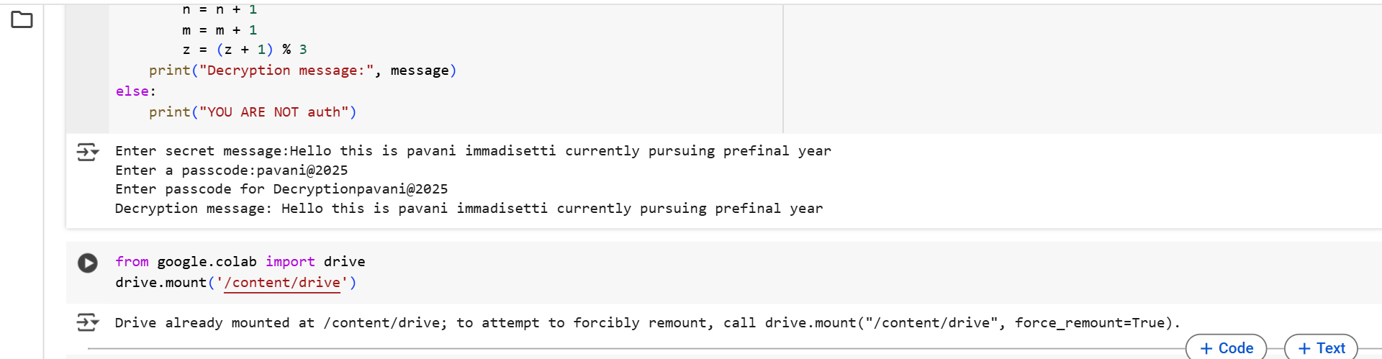
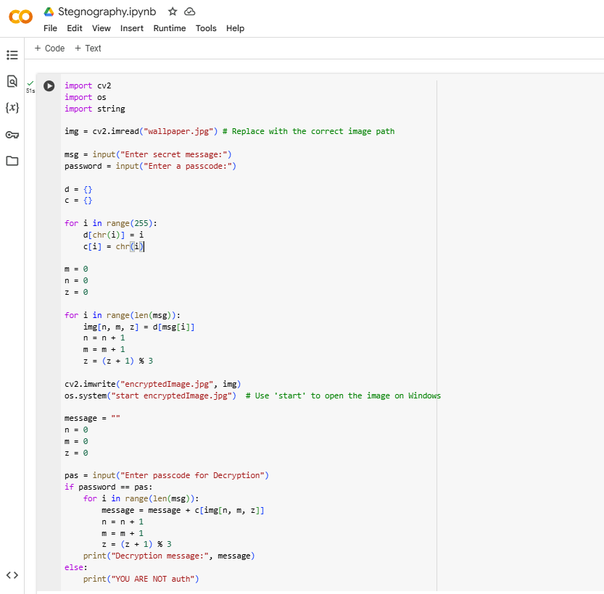
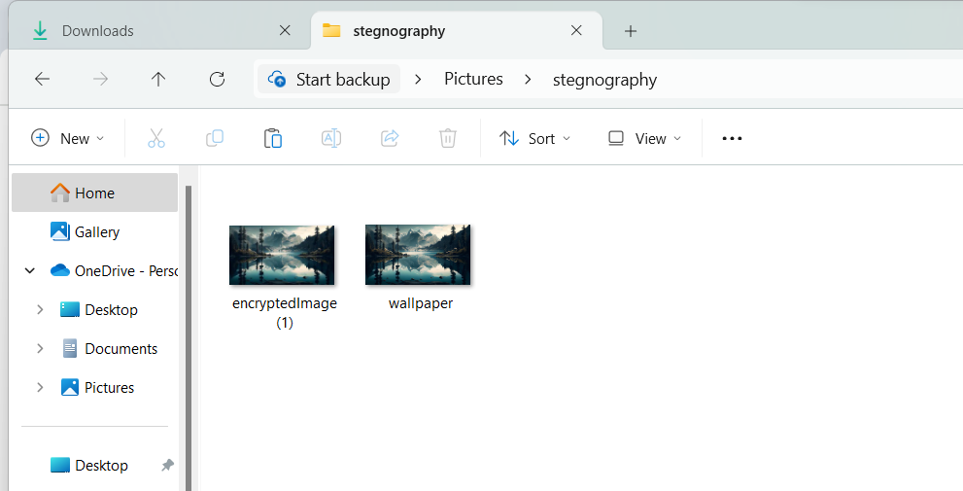
Results

Slide 8
Conclusion
This project successfully addresses the challenge of securely hiding data within an image using LSB-based steganography. In today's digital age, where data security and privacy are paramount, this project introduces an innovative and covert method for secure communication. By utilizing image steganography with Least Significant Bit (LSB) encoding, it enables users to discreetly embed messages within images while preserving their visual integrity. Unlike conventional encryption techniques that can attract attention, this approach ensures that sensitive information remains hidden in plain sight, significantly reducing the risk of interception or unauthorized access.
To further enhance security, password protection is integrated, allowing only authorized users to extract and decode the concealed message. This robust technique is invaluable for cybersecurity professionals, investigative journalists, corporate entities, and privacy-conscious individuals who need a reliable, efficient, and undetectable means of transmitting confidential data.
.

Slide 9
GitHub Link
https://github.com/Pavanisetty124/My-project
Description
This project implements Least Significant Bit (LSB) steganography to hide and extract secret messages within BMP images.
Repository Contents:
📂 Source code– Python program for embedding and extracting hidden messages.
📂 Sample Images – JPG images used for testing steganography.
📂 Documentation – Project report, explanations, and implementation details.
📂 Presentation – PPT slides summarizing the projec

Slide 10
Future scope(optional)
🔒 Enhanced Security with Cryptographic Integration – Combine steganography with encryption techniques like AES or RSA to create a double-layered security mechanism, making hidden data even more secure.
🌐 Cloud-Based Steganographic Services – Develop online platforms or APIs that allow users to securely hide and retrieve data in images through cloud-based solutions.
📱 Steganography in Mobile Applications – Implement steganographic techniques in messaging apps for secure communication, enabling users to send hidden messages within images or videos.
🎥 Video Steganography – Extend steganographic methods to video frames, allowing for covert communication through video content without noticeable distortion.
🤖 AI-Powered Steganalysis Resistance – Use machine learning and deep learning to improve resistance against steganalysis (detection techniques), making hidden data even harder to find.

Slide 11
THANK YOU

